Slide 1
Barriers to Effective Communication and Their Management
Presented By:
Kumar Kartikain Shivam

Slide 2
Points of Discussion
Communication-what it is?
Significance of communication
Process of Communication
Barrier?
Barriers to communication

Slide 3

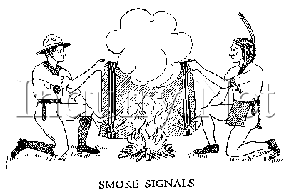
COMMUNICATION
Tuğçe AYDIN

Slide 4
What is communication?
Communication is a process through which two or more people exchange information, ideas, thoughts, emotions in such a way that each gain a common understanding of the intended message.
Communication is a dyadic concept.
In Communication system 35% message is carried verbally and rest of the 65% non verbally.

Slide 5
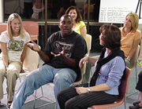
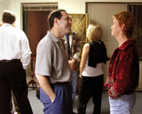
COMMUNICATION
Communication is the process of sending and receiving messages between parties

Slide 6
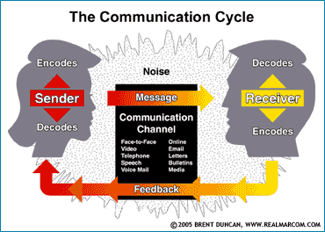
Basic Model Of Communication

Slide 7
Source
Encoded
Channel
Decoded
Receiver
Feedback

Slide 8
Significance of Communication
Lifeblood of an individual, organisation, society
As you grow you communicate more and more
In all domains of life and in all directions Downwards Sideways Upwards

Slide 9
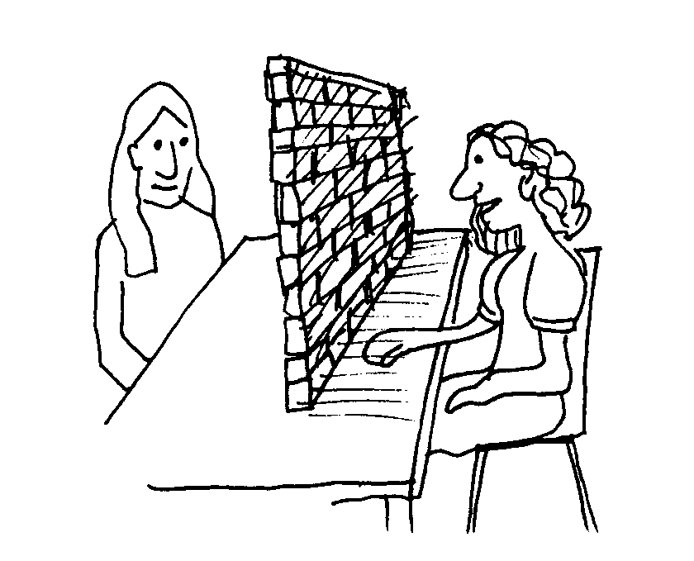
BARRIERS FOR EFFECTIVE COMMUNICATION

Slide 10
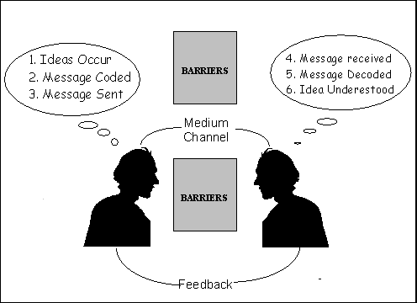

Slide 11
What is a Barrier ?
Lack of Commonness is barrier
A barrier to interpersonal communications is anything that prevents, restricts or impedes the conveyance of meaning by words or gestures between two or more persons in a social setting.
The term ‘Barriers’, ‘Obstacles’, ‘ Hindrances’ and ‘noise’ are all used to describe the distracting stimuli
associated with the
communication process
Absence of defined role of any component = Creates Barrier

Slide 12
Barriers to Effective Communication
Social
Psychological
Cultural
Physiological,
System design
Physical
Receivers

Slide 13
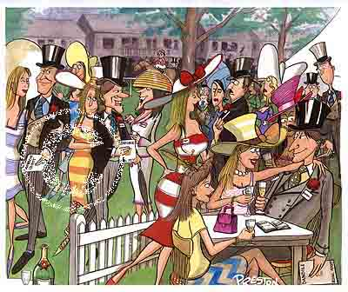
Social Barriers
Gender
Age
Race
National or Cultural Origin
Socioeconomic Class
Education Level
Urban or Rural Residence

Slide 14
GENDER
Major influence on the way we communicate with others.
When men and women work together in a group, men tend to be more assertive and self-confident.
Women are more likely than men to express their emotions, to reveal how they feel about a situation.

Slide 15
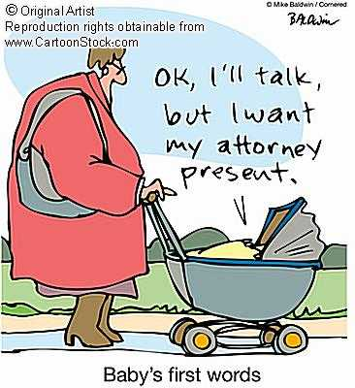
AGE
Young people and old people communicate in different ways.
We do tend to judge a statement by different standards if we know the speaker’s age.
A person’s age or gender is not
important in judging the truth or
wisdom of what that person says .

Slide 16
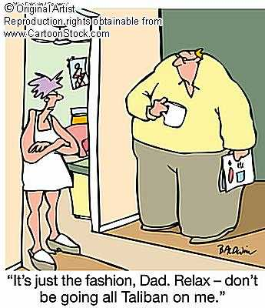
Their maturity, their educational backgrounds, and the different eras in which they grew up make a Generation Gap inevitable.

Slide 17
Social Barriers Cont…..
Purpose of Communication
  Informative, entertaining and persuasive
  Purpose not clear/missing/at odds
Social Noise/Subjective factors
  Human relation/ personal preferences overshadow the objectivity of the communication.
  Boys/Girls, Friends/enemies, Nice people
Try to ensure the Objectivity. Do not get dragged by
Subjective factors.

Slide 18
Psychological Barriers
Attitude towards self
Fear
Attitude towards audience
Attitude towards the message
You Yourself is not convinced with the subject
Knowledge of subject
Personality/Status of the communicator

Slide 19
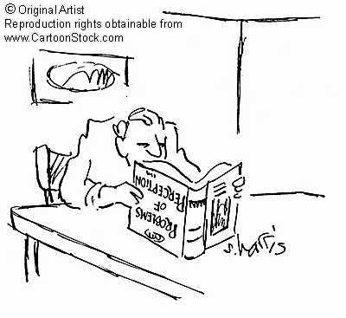
PERCEPTION
Our physical limitations are a screen through which we perceive things that exist in our environment.
Our perception is also limited by psychological screens that we have developed.
Choosing from among the many things within our range of perception those that we will notice, and block out the rest is called “Selective Perception”

Slide 20
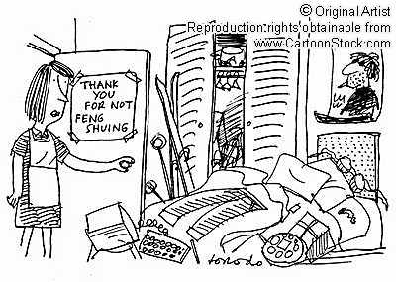
Mother: Will you straighten up your room?
Teenager: Why? What’s messy?

Slide 21
Selective Perception
Allows us not only to block out things that are there, but also to see more things than are there.
Leads us to make our own reality!
Most clearly seen in the human tendency to stereotype others.

Slide 22
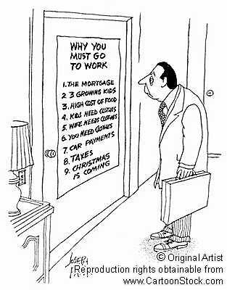
MOTIVATION
A Motive is a Reason For Action!
The most strongest
motivations are those
that are most personal.
We are motivated by money,
fame, power, love, status, security,
skill, ambition...etc
it can be both positive
or negative.

Slide 23
TUNNEL VISION
A closed way of thinking, especially about abstract topics, such as religion and politics.
The person with tunnel vision is one who has firmly fixed ideas
The opposite side is open-mindedness
Person with tunnel vision has attitude seems to say; “I’ve already made up my mind, Don’t confuse me with the facts!!!”

Slide 24
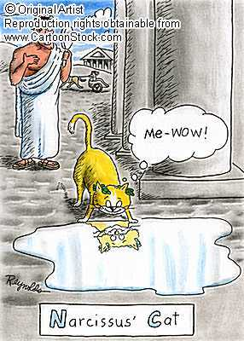
EGO DEFENSIVENESS
A response pattern in which a person who follows this pattern sees a disagreement as a personal
attact .
A self-centered communication
More than just being selfish

Slide 25

NEGATIVE EMOTIONS
Almost always obstacles to good communication!
Especially true barrier if the emotion is uncontrolled, unfocused, or misdirected.

Slide 26
Other Psychological Barriers
People’s State of Mind
Happy, Sad
Personal Problems/Worries
Pre conceived notions of Communicator or Receiver
Mental limitations of human beings, failure to refer language to experience, the confusion of concept.

Slide 27
Cultural Barriers
Semantic Problems: Distortion in communication comes from semantics- the use of words or expressions which have a different meaning for the sender or receiver.
Created when communicators use technical jargon- usage common to a particular field or specialization.

Slide 28
Cultural Barriers
Language
Different languages, dialect, individual linguistic ability, use of difficult words, inappropriate words, pronunciation
Norms and values
Belief
Social practices and traditions

Slide 29
Physiological Barriers
Individuals’ personal discomfort
ill health, poor eye sight, hearing difficulties
Speech and voice defect, feeling of inferiority, diseases, physical appearance, lack of skill.

Slide 30
System Design
Organisational Structure
unclear, to whom to communicate,
Insufficient or inappropriate information systems
Information overloaded
A lack of clarity in roles and responsibilities
A lack of supervision or training

Slide 31
The distortion of message is any kind of loss, deformation, miss presentation or alteration taken place in original message while sending it to audience.
Types of Distortion :
1. Systematic Distortion – Purposely changed
2. Fog Distortion – information is lost
3. Mirage Distortion - extra, unwanted information

Slide 32
Status And Power Differences
Differences in
communications are
likely to parallel the
differences in power.
Imbalance or asymmetry
in negotiating power
leads the high power
party to perform
significantly better than
the low power party.

Slide 33
Physical Barriers
Channel
  Availability of channel to receiver (Common channel)
  Choice of channel
  Handling of channel by communicator
  Reach : depending on size of audience, mike, etc.
  Noise level in Channel
  Presentation of information/message treatment
  Muddled messages
  “Dogs for sale.Will eat anything.Especially likes children. Call 888-3599 for more information.”
Climate
  Extreme temperature (Hot/Cold)
  Bright/ Dim Light
  High Humidity
Comfort

Slide 34
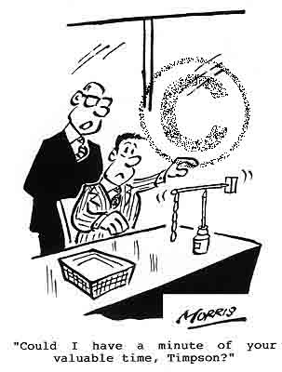
Physical Barriers Cont…..
Distractions:It occurs where people
are constantly coming
in and leaving for one
reason or another, and
experinced the
frustration that is
created by this
distracting traffic flow.

Slide 35
Physical Barriers Cont…..
Distractions
  Noise (Co-workers, Doors, etc.)
  Photographer
  Any announcements
  Instruction Sheet
  Tea
  Late Comers
Physical Setting of Classroom/ Lecture Hall
  Sitting Arrangement
  Audio-Visual Aids

Slide 36
Receiver-The Ultimate
Absenteeism/Day Dreaming/ Pretending Listening
Strayers: They constantly take the group off the track. They drag the discussion out of context
Gabbers: They are the people who like to talk first and try to dominate in the discussion. They think that they are the only ones with anything worth saying
Silent: They are just as well informed as many other members of the group but they rarely contribute verbally
Listening without observing speaker’s tone, gesture, posture and
facial expression is like getting the words of a song without music

Slide 37
Relating to Receiver
Problem of homogeneity: The more homogeneous
the audience is, the greater are the chances
for successful communication.
Problem of cooperation and involvement: The listeners must cooperate and get actively involved in
the communication process, they must try to get
tuned together with the communicator.
Negative attitude of the audience towards the communicator: If the audience has negative attitude
for the communicator or if the credibility of
communicator as perceived by the audience is low,
no successful communication will take place.

Slide 38
Problems in Communication
Relating to communicator
Ineffective environment: The environment created by the communicator influences his effectiveness. The physical facilities, air of friendliness, rapport with the audience etc.
Unorganized efforts to communicate: Unorganized efforts will distort the message and it will not reach its destination as intended. e. g. Timely
Poor standard of correctness: Standard of correctness involves proper selection of the message and its level of accuracy.
Inaccurate symbols: If the symbols used in communication are inaccurate, intended communication will not take place.

Slide 39
Problems in Communication
Relating to Transmission of Message
Wrong handling of the channels: If the channels selected for communication are not handled effectively, their potential for carrying a message will be dissipated.
Wrong selection of channels: If the channel selected is not in accordance with the objective/subject, interpretation will not be in a desired way.
Use of inadequate channels in parallel: For the message to have got through and received properly, use of more than one channel in parallel or at about the same time is essential.
Physical distraction: Failure to avoid physical distraction often obstructs successful sending of the message.

Slide 40
Points to Remember
Communication is a two way process.
Effective communication= Bridging the gap between encoded and decoded message= Establishing Common Understanding
Responsibility of effective communication mainly lies with the communicator
Feedback is an important return message. Ensure getting and using it effectively for better performance
Know the roadblocks. This will help you to handle the communication process in an effective way
Use Heart and Mind and Soul for an effective result
Communication is a skill, learn and practice

Slide 41
To Sum up
To Become an Effective communicator
Make effective use of
Heart and Body, Mind and Soul

Slide 42
Thanks
Any Questions?
Reach out to Me at:
Kartikain.30819@lpu.co.in

